Slide 1
Gifs!
Aesculap 1

Slide 2
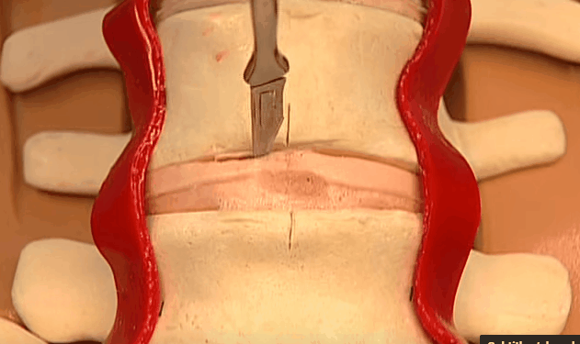
Step 1: Incision

Slide 3
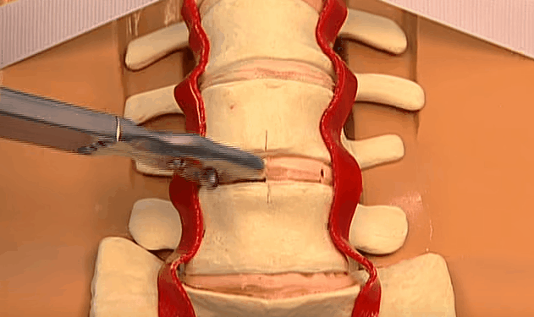
Step 2: Discectamy

Slide 4
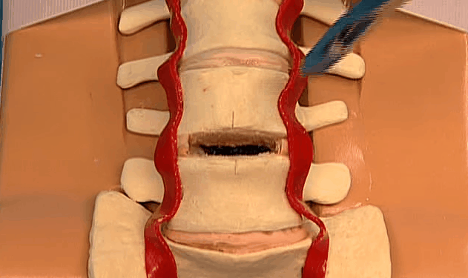
Step 3: Profit

Slide 5
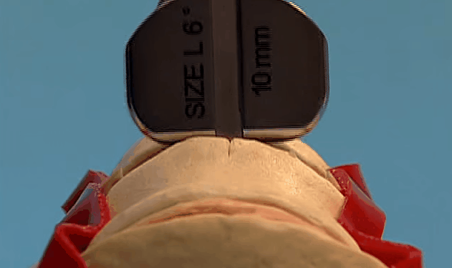
Step 4: Insertion

